Slide 1
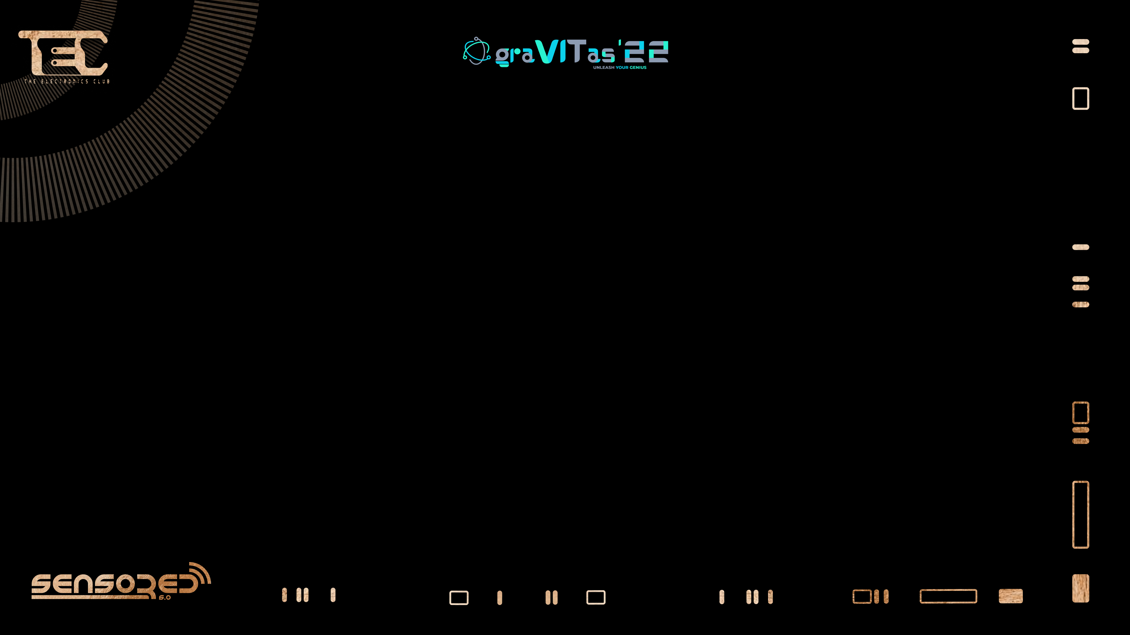

Micro controllers
Micro processors
cessors

Slide 2
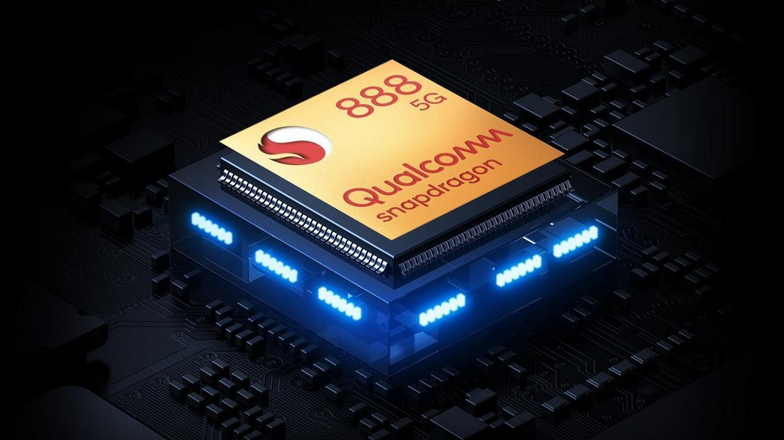
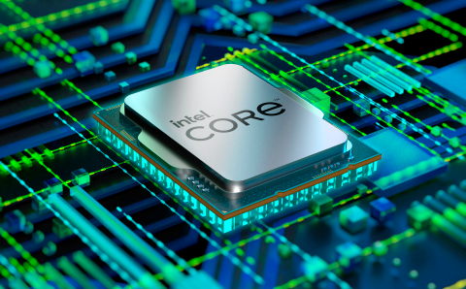
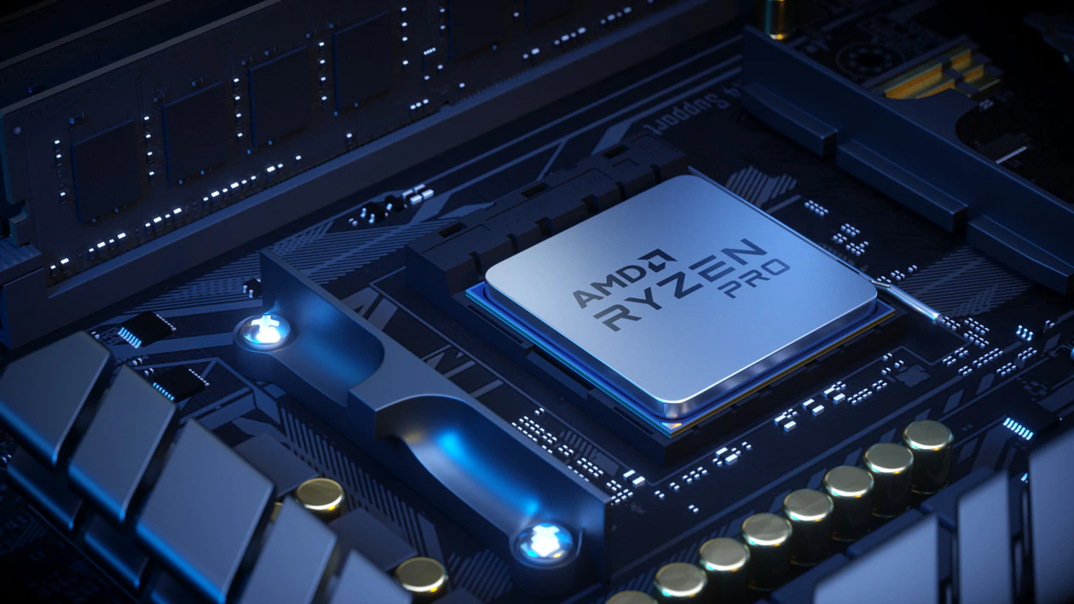
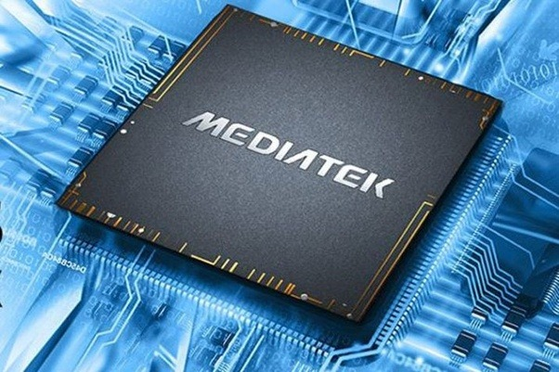
processors
MICROPROCESSORSOR

Slide 3
A microprocessor is a computer processor where the data
processing logic and control is included on a single
integrated circuit, or a small number of integrated circuitf integrated circuits.

Slide 4


Slide 5
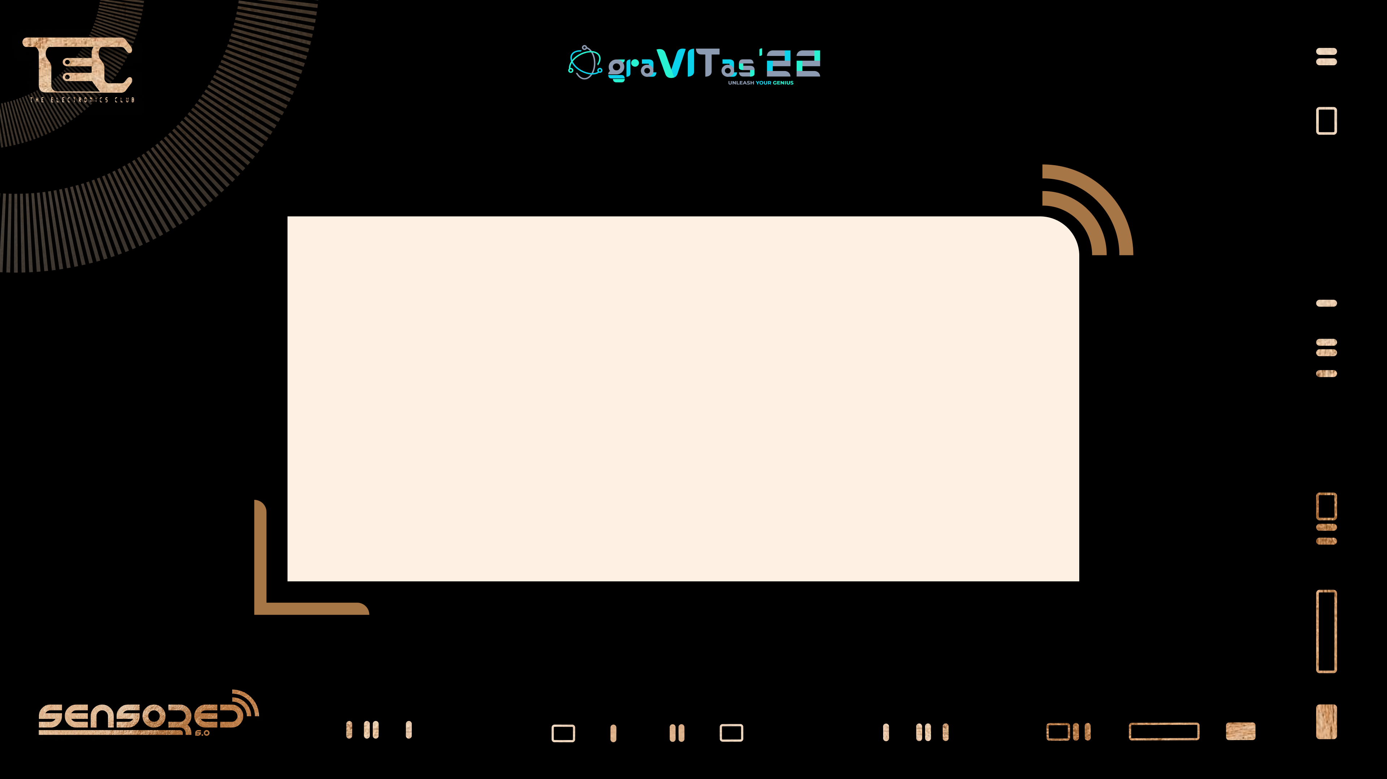
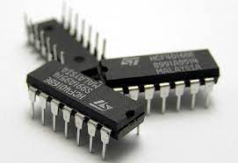
Notes:
Microprocessor is the part of computer which processes the input information and provide the desired output according to the given command

Slide 6
Parts of microprocessor
1.the input unit
2.the output unit
3.the arithmetic logic unit (ALU)
4.the control unit

Slide 7

INPUT UNIT
The input unit consists of all of the devices used to take information and
data that are external to the computer.
OUTPUT UNIT
The output unit consists of the devices used to transfer data and
information from the computer to the “outside world.”

Slide 8
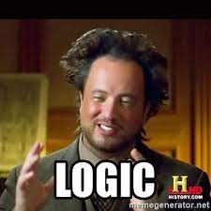
ARITHMETIC LOGIC UNITUNIT (ALU)
The arithmetic and logic unit (ALU) is that part of the computer
that actually performs arithmetic and logical operations on data.
All other elements of the computer system - control unit , memory,
I/O are there mainly to bring data into the ALU to process and
then to take the results back out.
.
Notes:
All the logic operations takes place from basic adding two numbers to complex equations

Slide 9
Control unit
Control unit is like the conductor of an orchestra, who is responsible for
keeping each of the orchestra members in proper synchronization. This
unit contains logic and timing circuits that generate the proper signals
necessary to execute each instruction in a program
Notes:
IT’s like the manager of microprocessor , its job is to manage or you can say to input signal for proper and synchronized executoperations in proper order

Slide 10


Slide 11
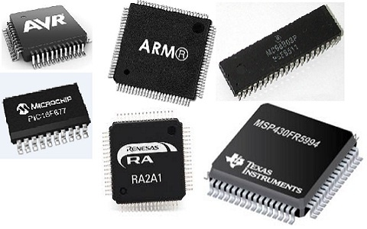
Microcontrollers

Slide 12
A microcontroller is a compact integrated circuit designed to
govern a specific operation in an embedded system.
A typical microcontroller includes a processor, memory and
input/output (I/O) ports on a single chip.

Slide 13

Now What The Hell Is
EMBBEDED SYSTEM
Notes:
microcontroller or microprocessor based system which is designed to perform a specific task. So in the embedded system microcontroller acts as an governing body

Slide 14
Parts of microcontrolers
ADC
CPU
MEMORY
I/O PORTS
TIMERS/COUNTERS
INTERRUTPS

Slide 15
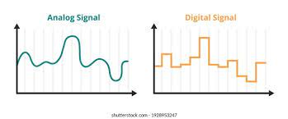

ANALOG DIGITAL CONVERTER
Analog digital converter is the device that converts analog signal to digital signal which is important for working of microcontroller

Slide 16
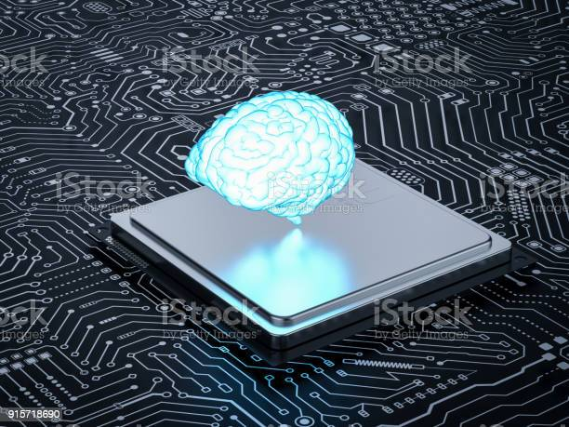
THE PROCESSOR (CPU) -
The processor (CPU) -- A processor can be thought of as the brain of the device.
It processes and responds to various instructions that
direct the microcontroller's function.

Slide 17

MEMORY
A microcontroller's memory is used to store the data that the processor receives and uses to respond or execute functions or instructions that it's been programmed to carry out.
Notes:
Storage unit

Slide 18
TIMERS
A timer is a specialized type of clock which is used to measure time intervals. A timer that counts from zero upwards for measuring time elapsed is often called a
stopwatch.

Slide 19
COUNTERS
A counter is a device that stores (and sometimes displays) the number of times a particular event or process occurred, with respect to a clock signal. It is used to count the events happening outside the microcontroller

Slide 20

INTERRUPTS
It is a method of creating a temporary halt
during a program execution and allow input
output devices to access the microprocessor

Slide 21
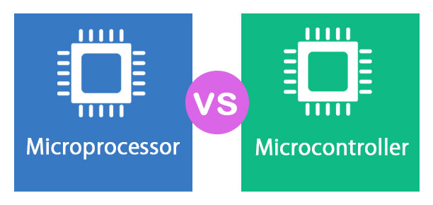

Slide 22
MICROPROCESSOR | MICROCONTROLLER
Microprocessors have externally attached input and output ports | Microcontrollers have inbuilt input output ports
They do not have there own memory | They have there own memeory
Microprocessors are usually general purpose device | Microcontroller are designed to carry out very specific operation
It is mainly used in personal computers Mobile phones etc. | It is mainly used in washing machines, air conditioners etc.

Slide 23

Thank you

